Slide 1
Fabrikam, Inc.
Bid Package Overview

Slide 2
Our Mission
To lay the foundations for our clients’ dreams

Slide 3

The Bid Team
Scott Bishop, Lead Engineer
Kevin McDowell, Lead Site Planner
Ken Myer, Chief of Field Operations
Notes:
Introduce the team.
Open the floor to questions about team’s experience and training.

Slide 4
Who We Are
The Southeast’s leading piledriving and heavy concrete construction company
A company with 86 years of heavy construction experience
Our competitive advantages:
  The most experienced piledriving crew in the region
  Ability to work in any climate, in any conditions
  Land-based and marine-based rigs
  Heaviest-duty lifting and pouring technologies in the entire industry
Notes:
Brief history of company.
Purchased A&L Piledriving in 1984 and Pitts Heavy Construction in 1991.
Our field supervisors and full-time crews have nearly 1,000 years of combined experience.
Worked in many operating environments.
Entire crane and rig fleet upgraded in 2014.
Heaviest crawler and truck-mounted cranes in the industry.

Slide 5
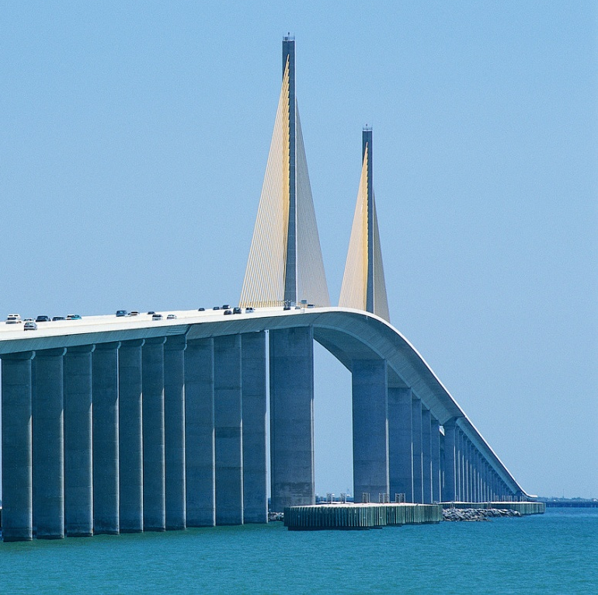
Key Successes
Transportation
  US 101 overpass
  Sky Tower bridge
  South State runway
Industrial
  A&B power plant
  Jones mill expansion
Marine
  Bay tunnel rebuild

Slide 6
Star References
Bay Transportation Authority
City Airport Authority
The Power Company
A&B Utilities
State Utility Commission
State University
Bay Marine and Tunnel Commission
Notes:
Detailed contact information is available in the bid package.

Slide 7
Our Bid in Brief
Planning and Design: $345,650
Materials: $1,750,000
Equipment Leasing: $448,970
Labor: $2,135,000
Security: $112,000
Site Preparation: $1,125,500
Final Installation: $2,234,900
Notes:
Details and cost breakouts are in the bid package.
Final installation cost includes labor.

Slide 8

Key Issues
Smith Creek diversion
Traffic control
Heavy crane relocation
Ground support in lift area
Site security
Weather
Overhead power lines
Notes:
City engineers already have plans for creek diversion.
To lower costs, city or county could provide traffic control.
Substrate must be compacted and reinforced to support cranes and material stores.
Will work with power company to ground or relocate overhead lines.

Slide 9
Schedule
Task | Start Date – End Date
Planning & Design | January 8 – February 24
Review & Approval | March 1 – March 30
Site Preparation & Creek Diversion | April 15 – July 30
Piling Installation | June 25 – August 20
Concrete Installation | July 1 – September 30
Final Inspection | October 20 – October 30
Walk-Off | November 5

Slide 10
Contact Us
Fabrikam, Inc.
  345 Third Street
  Mobile, AL 01234
  (912) 555-0150
sales@fabrikam.com
www.fabrikam.com

